Slide 1
Module Two: Service Message Exchange SOAP and Service Description WSDL

Slide 2
Introduction

Slide 3
Web Service Protocol Stack
Searching / Publishing Web Services
Discovery UDDI
Description WSDL
Describing Web Services interface
XML Messaging XML-RPC, SOAP,XML
Transport HTTP,SMTP,FTP, BEEP
Encoding messages in XML format
Transporting XML messages between client and server
3

Slide 4
Web service basics
An organization exposes its business applications as services on the Internet and makes them accessible via standard programmatic interfaces

Slide 5
Web service basics
The Web services technology provides a uniform and loosely coupled integration framework to increase cross-language and cross-platform interoperability for distributed computing and resource sharing over the Internet

Slide 6
Web service basics
The paradigm of Web services opens a new cost-effective way of engineering software to quickly develop and deploy Web applications, by dynamically integrating other independently published Web service components into new business processes

Slide 7
Credit Card
Hotel
Airline
Travel Agency 1
Travel Agency 2
Travel Agency 3
…
…
Service Registry
PUBLISH
Travel Agency 1
PUBLISH
PUBLISH
Travel Agency 2
Travel Agency 3
Service providers

Slide 8
Credit Card
Hotel
Airline
Travel Agency 1
Travel Agency 2
Travel Agency 3
…
…
Service Registry
Travel Agency 1
DISCOVER
Travel Agency 2
Travel Agency 3
Client App
Service providers
Service requestor

Slide 9
Credit Card
Hotel
Airline
Travel Agency 1
Travel Agency 2
Travel Agency 3
…
…
Service Registry
Travel Agency 1
Service provider
BIND
Client App
Service requestor

Slide 10
Credit Card
Hotel
Airline
Travel Agency 1
Travel Agency 2
Travel Agency 3
…
…
I need to find someone who provides hotel services… Also some airlines and payment services would be great
Service Registry
Travel Agency 1
Client App

Slide 11
Credit Card
Hotel
Airline
Travel Agency 1
Travel Agency 2
Travel Agency 3
…
…
Service Registry
DISCOVER
Travel Agency 1
Service requestor
Client App

Slide 12
Credit Card
Hotel
Airline
Travel Agency 1
Travel Agency 2
Travel Agency 3
…
…
Credit Card
Hotel
Service Registry
Travel Agency 1
Airline
Service requestor
Client App

Slide 13
Credit Card
Hotel
Airline
Travel Agency 1
Travel Agency 2
Travel Agency 3
…
…
Service providers
Credit Card
Hotel
Service Registry
Hotel
Hotel
BIND
Travel Agency 1
BIND
Service requestor
BIND
Airline
Airline
Airline
Client App

Slide 14
Credit Card
Hotel
Travel Agency 1
Airline
Client App

Slide 15
WSDL provides a notation to answer the following three questions:
What is the service about?
Where does it reside?
How can it be invoked? (i.e., what, where, and how)
Credit Card
Hotel
Travel Agency 1
Web Service Description
Travel Agency 1
Airline
Client App
A client program connecting to a Web service can read the WSDL file to determine what operations are available on the server

Slide 16
WSDL - a standard for describing Web Services
Credit Card
Credit Card
Web Service Description
Hotel
Hotel
Web Service Description
Travel Agency 1
Web Service Description
Travel Agency 1
Airline
Airline
Web Service Description
Client App
A client program connecting to a Web service can read the WSDL file to determine what operations are available on the server

Slide 17
SOAP - a standard for accessing Web Services
Credit Card
Hotel
INVOKE
INVOKE
Travel Agency 1
INVOKE
Airline
INVOKE
Client App
Service requestor uses SOAP to call one of the operations listed in the WSDL file

Slide 18
Service Message Exchange SOAP

Slide 19
Web Service Protocol Stack
Discovery UDDI
Description WSDL
XML Messaging XML-RPC, SOAP,XML
Transport HTTP,SMTP,FTP, BEEP
Encoding messages in XML format
19

Slide 20
Using the Protocols Together – service provider perspective
Step 1:
Create core functionality
Step 2:
Create an XML-RPC or SOAP service wrapper
Step 3:
Create WSDL service description
or XML-RPC integration instructions
Step 4:
Deploy service
Step 5:
Register new service via UDDI

Slide 21
Using the Protocols Together – service request perspective
Step 1:
Find Services via UDDI
Step 2:
Retrieve Service Description File:
WSDL or XML-RPC Instructions
Step 3:
Create XML-RPC or SOAP Client
Step 4:
Invoke Remote Service
A client program reads a WSDL document to understand what a Web service can do; then it uses SOAP to actually invoke the functions listed in the WSDL document.

Slide 22

SOAP
SOAP is an XML-based protocol for exchanging information between computers.
Enables client applications to easily connect to remote services and invoke remote methods
For example, a client application can immediately add language translation to its feature set by locating the correct SOAP service and invoking the correct method.
Although SOAP can be used in a variety of messaging systems and can be delivered via a variety of transport protocols, the initial focus of SOAP is remote procedure calls transported via HTTP.

Slide 23
SOAP vs other frameworks SOAP evolved as a successor of XML-RPC
Other frameworks, including CORBA, DCOM, and Java RMI, provide similar functionality to SOAP, but SOAP messages are written entirely in XML and are therefore uniquely platform- and language-independent.
For example, a SOAP Java client running on Linux or a Perl client running on Solaris can connect to a Microsoft SOAP server running on Windows 2000.
SOAP therefore represents a cornerstone of the web service architecture, enabling diverse applications to easily exchange services and data.

Slide 24
SOAP uses
B2B – Business to Business
EAI - Enterprise application integration

Slide 25
B2B using SOAP

Slide 26
EAI using SOAP

Slide 27
The SOAP specification
The SOAP specification defines three major parts:
SOAP envelope specification
Data encoding rules
RPC conventions

Slide 28
SOAP envelope specification
The SOAP XML Envelope defines specific rules for encapsulating data being transferred between computers.
application-specific data, such as the method name to invoke, method parameters, or return values.
information about who should process the envelope contents
in the event of failure, how to encode error messages

Slide 29
Data encoding rules
To exchange data, computers must agree on rules for encoding specific data types.
For example, two computers that process stock quotes need an agreed-upon rule for encoding float data types; likewise, two computers that process multiple stock quotes need an agreed-upon rule for encoding arrays.
SOAP therefore includes its own set of conventions for encoding data types. Most of these conventions are based on the W3C XML Schema specification.

Slide 30
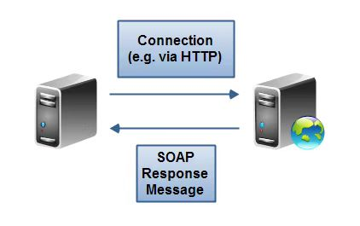
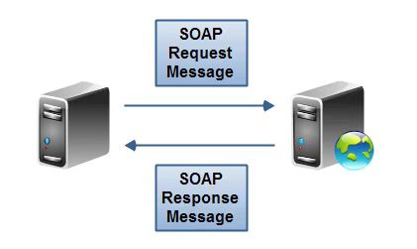
RPC conventions
SOAP can be used in a variety of messaging systems, including one-way and two way messaging.

Slide 31
SOAP Message – one way messaging
The SOAP client connects to the service, but does not send a SOAP message through
A one-way message
An HTTP request from a client
A SOAP response from a service

Slide 32
RPC conventions – two way messaging
For two-way messaging, SOAP defines a simple convention for representing remote procedure calls and responses.
This enables a client application to specify a remote method name, include any number of parameters, and receive a response from the server.

Slide 33
Data encapsulation concepts
SOAP message
Represents the information being exchanged between 2 SOAP nodes.

Slide 34
SOAP message example

Slide 35
SOAP Message - elements
Mandatory elements
Envelope element
Body element
Optional elements
Header element
Fault element
Each of these elements has an associated set of rules

Slide 36
SOAP Message - Envelope
It is the enclosing element of an XML message identifying it as a SOAP message

Slide 37
SOAP Message - Header
Contains header information
application-specific context information (for example, security or encryption information) that is associated with the SOAP message

Slide 38
SOAP Message - Body
Contains the body of the message intended for the SOAP receiver
Contains call and response information

Slide 39
SOAP Message - Fault
Contained within the SOAP body as a child element
Provides information about errors that occurred while processing the message
In case a SOAP node fails to process a SOAP message, it adds the fault information to the fault element

Slide 40
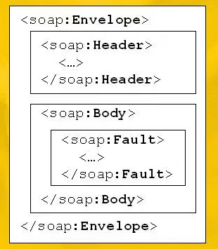
SOAP message without and with a Fault

Slide 41
Example
XMethods.net provides a simple weather service, listing current temperature by zip code. The service method, getTemp, requires a zip code string and returns a single float value.

Slide 42
SOAP Request

Slide 43
SOAP Request - XML namespaces

Slide 44
SOAP Request - XML namespaces
In our sample SOAP request, a total of four XML namespaces are defined to disambiguate identifiers associated with
the SOAP Envelope (http://schemas.xmlsoap.org/soap/envelope/)
data encoding via XML Schemas (http://www.w3.org/2001/XMLSchema-instance and http://www.w3.org/2001/XMLSchema)
application identifiers specific to Xmethods (urn:xmethods-Temperature)

Slide 45
SOAP Request - XML namespaces
Namespaces are used to disambiguate XML elements and attributes, and are often used to reference external schemas.
Disambiguation links the named entities to a unique identifier
This enables application modularity, while also providing maximum flexibility for future changes to the specifications.

Slide 46
XML namespace declaration
An explicit XML namespace declaration takes the following form:
<prefix:myElement
xmlns:prefix ="URI">
The declaration defines prefix as an alias for the specified URI
In the element myElement, you can use prefix with any element or attribute to specify that the element or attribute name belongs to the namespace specified by the URI
An example of a namespace declaration:
<SOAP-ENV:Envelope
xmlns:SOAP-ENV="http://schemas.xmlsoap.org/soap/envelope/"
This declaration defines SOAP-ENV as an alias for the namespace: http://schemas.xmlsoap.org/soap/envelope/
After defining the alias, you can use it as a prefix to any attribute or element in the Envelope element.

Slide 47
SOAP Request – an example

Slide 48
SOAP Request - XML namespaces
An XML namespace defined to disambiguate identifiers associated with
the SOAP Envelope (http://schemas.xmlsoap.org/soap/envelope/)

Slide 49
SOAP Request
This namespace declaration defines SOAP_ENV as an alias for the namespace: http://schemas.xmlsoap.org/soap/envelope/

Slide 50
SOAP Request
After defining the alias, you can use it as a prefix to any attribute or element in the Envelope element.

Slide 51
SOAP Request - XML namespaces
An XML namespace defined to disambiguate identifiers associated with
data encoding via XML Schemas (http://www.w3.org/2001/XMLSchema-instance and http://www.w3.org/2001/XMLSchema)

Slide 52
SOAP Request

Slide 53
SOAP Request

Slide 54
SOAP Request - XML namespaces
An XML namespace defined to disambiguate identifiers associated with
application identifiers specific to Xmethods (urn:xmethods-Temperature)

Slide 55
SOAP Request

Slide 56
SOAP Request - XML namespaces
In our sample SOAP request, a total of four XML namespaces are defined to disambiguate identifiers associated with
the SOAP Envelope (http://schemas.xmlsoap.org/soap/envelope/)
data encoding via XML Schemas (http://www.w3.org/2001/XMLSchema-instance and http://www.w3.org/2001/XMLSchema)
application identifiers specific to Xmethods (urn:xmethods-Temperature)

Slide 57
SOAP Request

Slide 58
SOAP Request
The client request must include the name of the method to invoke and any required parameters.

Slide 59
SOAP Request
The Body element encapsulates the main "payload" of the SOAP message.
The only element is getTemp, which is tied to the XMethods namespace and corresponds to the remote method name.
Each parameter to the method appears as a subelement.
In our example, we have a single zip code element, which is assigned to the XML Schema xsd:string data type and set to 10016.
If additional parameters are required, each can have its own data type.

Slide 60
SOAP Response

Slide 61
SOAP Response
Just like the request, the response includes Envelope and Body elements, and the same four XML namespaces.
This time, however, the Body element includes a single getTempResponse element, corresponding to our initial request. The response element includes a single return element, indicating an xsd:float data type.

Slide 62
SOAP characteristics
Extensibility
Neutrality
SOAP can operate over any protocol such as HTTP, SMTP, TCP, UDP,…
Independence
SOAP allows for any programming model

Slide 63
Extensibility
SOAP features
SOAP provides a messaging framework only. However, it can be extended to add features such as reliability, security etc. There are rules to be followed when adding features to the SOAP framework
SOAP module
A collection of specifications regarding the semantics of SOAP header to describe any new features being extended upon SOAP
A module needs to realize zero or more features
SOAP requires modules to adhere to prescribed rules

Slide 64
SOAP benefits
SOAP allows developers to invoke processes running on different operating systems (such as Windows, macOS, and Linux) to authenticate, authorize, and communicate using Extensible Markup Language (XML)
Since Web protocols like HTTP are installed and running on practically all operating systems, SOAP allows clients to invoke web services and receive responses independent of language and platforms

Slide 65
Disadvantages
SOAP is less "simple" than the name would suggest. The verbosity of the protocol, slow parsing speed of XML, and lack of a standardized interaction model led to the dominance of services using the HTTP protocol more directly
for example, REST

Slide 66
Alternatives to SOAP Web services
REST
JSON

Slide 67
RESTful Web Services
RESTful APIs
Web service APIs that adhere to the REST architectural constraints
REST
Representational state transfer (REST) is a software architectural style that describes the architecture of the Web. It was derived from the following constraints:
client-server communication
stateless communication
caching
uniform interface
layered system
code on demand

Slide 68
SOAP vs REST
REST and SOAP both define how to build application programming interfaces (APIs), which allow data to be communicated between web applications
REST is a set of architectural principles
REST is not a standard in itself, but RESTful implementations make use of standards, such as HTTP, URI, JSON, and XML
SOAP is an official protocol maintained by the World Wide Web Consortium (W3C)

Slide 69
SOAP vs REST
Typically, an API will adhere to either REST or SOAP, depending on the use case and preferences of the developer
Many legacy systems may still adhere to SOAP, while REST came later and is often viewed as a faster alternative in web-based scenarios. REST is a set of guidelines that offers flexible implementation, whereas SOAP is a protocol with specific requirements like XML messaging.
https://www.redhat.com/en/topics/integration/whats-the-difference-between-soap-rest

Slide 70
SOAP vs REST
REST APIs are lightweight, making them ideal for newer contexts like the Internet of Things (IoT), mobile application development, and serverless computing
REST is a famous choice for building complex public APIs
Many social media platforms use RESTful APIs so that the users can integrate their applications/websites into the platform.
SOAP web services offer built-in security and transaction compliance that align with many enterprise needs
SOAP can be used as an architecture for the APIs to transfer highly confidential files and complex transactions of securities or wealth, payment gateways, telecommunications, and identity management services.
Paypal’s payment API is one of the well-known SOAP APIs. SOAP can be a good alternative wherever the REST API can’t be used.

Slide 71
JSON Web Services
JSON - JavaScript Object Notation
JSON vs SOAP
The content of a SOAP message is XML data, whereas a JSON message contains JSON data.
JSON and XML are different encoding mechanisms for describing structured data
JSON tends to be a more efficient encoding mechanism, so a typical JSON message will be smaller than the equivalent XML message.
More information about JSON web services
https://www.ibm.com/docs/en/cics-ts/5.3?topic=services-concepts-json-web
How to deploy a python machine learning model as a JSON web service – an example
https://developer.ibm.com/tutorials/deploy-a-python-machine-learning-model-as-a-web-service/

Slide 72
Service Description WSDL

Slide 73
Web Service Protocol Stack
Discovery UDDI
Description WSDL
Describing Web Services interface
XML Messaging XML-RPC, SOAP,XML
Transport HTTP,SMTP,FTP, BEEP
73

Slide 74
Using the Protocols Together – service provider perspective
Step 1:
Create core functionality
Step 2:
Create an XML-RPC or SOAP service wrapper
Step 3:
Create WSDL service description
or XML-RPC integration instructions
Step 4:
Deploy service
Step 5:
Register new service via UDDI

Slide 75
Using the Protocols Together – service request perspective
Step 1:
Find Services via UDDI
Step 2:
Retrieve Service Description File:
WSDL or XML-RPC Instructions
Step 3:
Create XML-RPC or SOAP Client
Step 4:
Invoke Remote Service
A client program reads a WSDL document to understand what a Web service can do; then it uses SOAP to actually invoke the functions listed in the WSDL document.

Slide 76
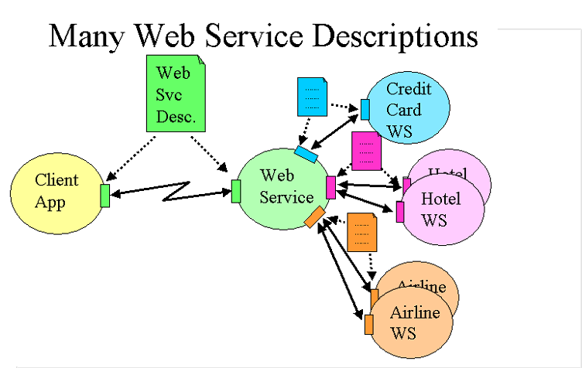
WSDL Essentials
Services can be used by other services or other programs
For services to interact, they must be aware of each other
This awareness is achieved through the use of “service descriptions”

Slide 77
Service Description
WSDL provides a notation to answer the following three questions:
What is the service about?
Where does it reside?
How can it be invoked? (i.e., what, where, and how)

Slide 78
What is WSDL
WSDL is a specification defining how to describe web services in a common XML grammar.
WSDL describes four critical pieces of data:
Interface information describing all publicly available functions
Data type information for all message requests and message responses
Binding information about the transport protocol to be used
Address information for locating the specified service

Slide 79
WSDL Benefits
Platform- and language-independent
Using WSDL, a client can locate a web service and invoke any of its publicly available functions.
With WSDL-aware tools, you can also automate this process, enabling applications to easily integrate new services with little or no manual code.
WSDL provides a common language for describing services and a platform for automatically integrating those services.

Slide 80
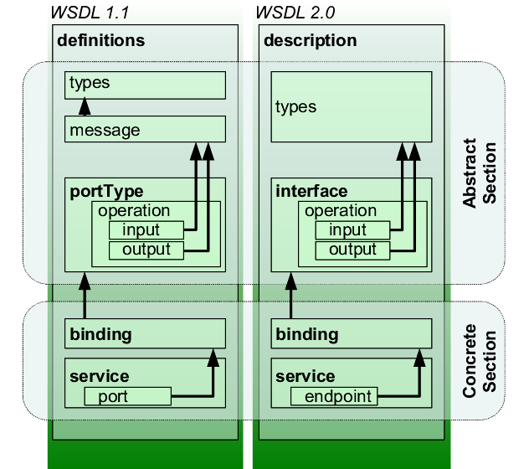
WSDL
An XML-based interface description language
Used for describing the functionality offered by a web service
WSDL describes services as collections of network endpoints or ports

Slide 81
WSDL Specification major Elements
definitions
types
message
portType
binding
service

Slide 82
WSDL Specification utility Elements
documentation
The documentation element is used to provide human-readable documentation and can be included inside any other WSDL element
import
The import element is used to import other WSDL documents or XML Schemas.
This enables more modular WSDL documents. For example, two WSDL documents can import the same basic elements and yet include their own service elements to make the same service available at two physical addresses.

Slide 83
Example - HelloService.wsdl
The service provides a single publicly available function, called sayHello.
The function expects a single string parameter
The function returns a single string greeting.
For example, if you pass the parameter world, the service returns the greeting: "Hello, world!"

Slide 87
Real example – Amazon SimpleDB
The Amazon SimpleDB API is published through a Web Services Description Language (WSDL) and an XML schema document.
https://docs.aws.amazon.com/AmazonSimpleDB/latest/DeveloperGuide/APIUsage.html
The Amazon SimpleDB WSDL is located at
http://sdb.amazonaws.com/doc/2009-04-15/AmazonSimpleDB.wsdl
The Amazon SimpleDB schema is located at
http://sdb.amazonaws.com/doc/2009-04-15/AmazonSimpleDB.xsd

Slide 88
Interoperability
Ability of services to connect and communicate with one another

Slide 89
Interoperability - can a Java class consume the .Net Web service?
Written in C#
Running on .NET platform
Travel Agency 1
Client App
Java class

Slide 90

Open Question
Points: 10
How does WSDL help achieve interoperability?
Open Question is only supported on Version 2.0 or newer.
Answer

Slide 91
WSDL Essentials
For services to interact, they must be aware of each other

Slide 92
Service Interfaces – in order to publish a business application on the Internet as a Web service, a necessary step is to define its interface in a standard way
Credit Card
Hotel
Travel Agency 1
Airline
Client App
interested users can then discover and access the service in a standard manner

Slide 93
Service Interfaces
Credit Card
Hotel
Travel Agency 1
Airline
Client App

Slide 94
Service Interfaces
Credit Card
Hotel
Travel Agency 1
Airline
Client App
WSDL describes the public interface to the Web service

Slide 95
Interface - Web Services Interoperability
Services interoperate based on a formal definition (WSDL) that is independent of the underlying platform and programming language
The interface definition hides the implementation of the language-specific service
SOA-based services can function independently of development technologies and platforms (Java, .NET, etc.)

Slide 96
WSDL file is what binds everything together
WSDL file is written in XML
XML can be read by any programming language
Both .Net and Java have corresponding commands that have the ability to work with XML
If the client application was written in .Net – it would understand the XML file
If the client app was written in Java – it could also interpret the WSDL file
Web services allow multiple applications built on various programming languages to talk to each other
We can have a .Net web application talking to a Java application via a Web service

Slide 97
Open Question
Points: 10
Why do you think interoperability is important for businesses?
Open Question is only supported on Version 2.0 or newer.
Answer

Slide 98
Web Services Interoperability
Universal accessibility
Standard interface description
Standard communication protocols
Can be implemented in different programming languages
Can be implemented on different platforms

Slide 99
Web Services Interoperability benefits
Facilitate B2B collaboration
Each organization exposes its business applications as services on the Internet and makes them accessible via standard programming interfaces
Facilitate distributed computing and resource sharing over the Internet
Cross-language and cross-platform
Cost effective way to quickly develop and deploy Web applications
Integrate other independently published Web service components into new business processes

Slide 100
Developing Web Services with WSDL

Slide 101
Does a Web Service need to be developed from scratch?
Widget, Inc. makes and sells components for smartphones. Their customers are major smartphone producers.
Currently, the ordering process is based on a legacy system:
Customer submits purchase orders by sending an email
Widget, Inc employee enters the purchase order in their “orders application”
To improve their business relationships, Widget, Inc. wants to start selling parts through its website, enabling customers to directly submit purchase orders and check on order status.

Slide 102
Open Question
Points: 10
You are a developer for Widget, Inc. You are asked to develop a Web service to expose the “order application” functions on the Internet and make it accessible to the existing and potential customers.
Can you reuse the existing “order application”? How?
Open Question is only supported on Version 2.0 or newer.
Answer

Slide 103
Does a Web Service need to be developed from scratch?
Any existing application can become a Web Service as long as it is wrapped by a Web Services interface (WSDL) and then published in a registry.

Slide 104
What if we do want to develop the web service from scratch?

Slide 105
Open Question
Points: 10
You are a developer for Widget, Inc. You are asked to develop a Web service
- If you want to develop the Web service from scratch – how do you start?
Open Question is only supported on Version 2.0 or newer.
Answer

Slide 106
What if we do want to develop the web service from scratch?
Start by modelling its potential interfaces before moving to implementation details
Widget, Inc
Purchase Orders
Client App

Slide 107
Application Design
107
Web service is defined in WSDL
Top-down
WSDL is created (or found) first before its implementation
Bottom-up
WSDL gets generated from existing JEE components
Middle-ground

Slide 108
Web Services Toolkits
Service Implementation
SOAP
manually
supply method
code
invoke a web service through SOAP request & response msgs
generate WSDL from web service code
Service
Implementation Skeleton
Client
WSDL
generate server implementation code
generate client proxy code for accessing a web service
108
Notes:
108
Much of this user's guide assumes you already have the implementation written, and are using the Web Service Builder to transform that existing application into a Web service. However, if you wish to create a new implementation for an existing Web service, the Web Service Builder can generate skeleton service code that you can use as a basis to develop a new implementation.
+ skeleton generated (WORD file)
A proxy class for a given service is typically created from its WSDL document
Once you write and deploy a WebMethod, clients need to know exactly what the SOAP messages need to look like in order to successfully communicate with it. The standard way to provide Web service descriptions is through WSDL (and embedded XSD definitions). To help accommodate this, the .asmx handler automatically generates both a human readable documentation page along with a WSDL definition that accurately reflects the WebMethod interface. If you've applied a bunch of mapping attributes to your WebMethods, they're all reflected in the generated documentation.

Slide 109
Service reusability
Service reuse is often mentioned as an important aspect of SOA
The aim is to create services that can be reused across a business
Does WSDL help with reusability?

Slide 110
WSDL and reusability
Recall the sections of WSDL document. How do you think WSDL helps with reusability of services?

Slide 111
WSDL
Web service is described as a set of communication endpoints (ports)

Slide 112
WSDL
Endpoint is made of two parts
Abstract definitions of operations and messages
Concrete binding to networking protocol (and corresponding endpoint address) and message encoding

Slide 113
WSDL Authoring Style Recommendation
Abstract and concrete portions of WSDL description are often defined in two or more files
Concrete file imports the abstract one
Why this separation?
Enhance reusability

Slide 114
WSDL Authoring Style Recommendation
To enhance Reusability and maintainability
Maintain WSDL document in 3 separate parts
– Data type definitions
– Abstract definitions
– Specific service bindings
Use “import” element to import necessary part of WSDL document

Slide 115
Example
Earlier, we have seen an example where a WSDL description was maintained as one file
Next, we will study an example where a WSDL description is maintained in three files

Slide 116
Example – to enhance reusability and maintainability
Maintain WSDL document in 3 separate parts
– Data type definitions
http://example.com/stockquote/stockquote.xsd
– Abstract definitions
http://example.com/stockquote/stockquote.wsdl
– Specific service bindings
http://example.com/stockquote/stockquoteservice.wsdl
Use “import” element to import necessary part of WSDL document
3 files instead of 1

Slide 117
http://example.com/stockquote/stockquote.xsd
<?xml version="1.0"?>
<schema targetNamespace="http://example.com/stockquote/schemas"
xmlns="http://www.w3.org/2000/10/XMLSchema">
<element name="TradePriceRequest">
<complexType>
<all>
<element name="tickerSymbol" type="string"/>
</all>
</complexType>
</element>
<element name="TradePrice">
<complexType>
<all>
<element name="price" type="float"/>
</all>
</complexType>
</element>
</schema>
Maintain WSDL document in 3 separate parts
– Data type definitions
– Abstract definitions
– Specific service bindings

Slide 118
http://example.com/stockquote/stockquote.wsdl
<?xml version="1.0"?>
<definitions name="StockQuote"
targetNamespace="http://example.com/stockquote/definitions"
xmlns:tns="http://example.com/stockquote/definitions"
xmlns:xsd1="http://example.com/stockquote/schemas"
xmlns:soap="http://schemas.xmlsoap.org/wsdl/soap/"
xmlns="http://schemas.xmlsoap.org/wsdl/">
<import namespace="http://example.com/stockquote/schemas"
location="http://example.com/stockquote/stockquote.xsd"/>
Use “import” element to import necessary part of WSDL document

Slide 119
Abstract part
<message name="GetLastTradePriceInput">
<part name="body" element="xsd1:TradePriceRequest"/>
</message>
<message name="GetLastTradePriceOutput">
<part name="body" element="xsd1:TradePrice"/>
</message>
<portType name="StockQuotePortType">
<operation name="GetLastTradePrice">
<input message="tns:GetLastTradePriceInput"/>
<output message="tns:GetLastTradePriceOutput"/>
</operation>
</portType>
</definitions>
Maintain WSDL document in 3 separate parts
– Data type definitions
– Abstract definitions
– Specific service bindings

Slide 120
http://example.com/stockquote/stockquoteservice.wsdl
<?xml version="1.0"?>
<definitions name="StockQuote"
targetNamespace="http://example.com/stockquote/service"
xmlns:tns="http://example.com/stockquote/service"
xmlns:soap="http://schemas.xmlsoap.org/wsdl/soap/"
xmlns:defs="http://example.com/stockquote/definitions"
xmlns="http://schemas.xmlsoap.org/wsdl/">
<import namespace="http://example.com/stockquote/definitions"
location="http://example.com/stockquote/stockquote.wsdl"/>
<binding name="StockQuoteSoapBinding“ type="defs:StockQuotePortType">
<soap:binding style="document" transport="http://schemas.xmlsoap.org/soap/http"/>
<operation name="GetLastTradePrice">
Use “import” element to import necessary part of WSDL document

Slide 121
Concrete part – specific service bindings
<soap:operation soapAction="http://example.com/GetLastTradePrice"/>
<input><soap:body use="literal"/> </input>
<output><soap:body use="literal"/></output>
</operation>
</binding>
<service name="StockQuoteService">
<documentation>My first service</documentation>
<port name="StockQuotePort" binding="tns:StockQuoteBinding">
<soap:address location="http://example.com/stockquote"/>
</port>
</service>
Maintain WSDL document in 3 separate parts
– Data type definitions
– Abstract definitions
– Specific service bindings

Slide 122
Example – to enhance reusability and maintainability
Maintain WSDL document in 3 separate parts
– Data type definitions
http://example.com/stockquote/stockquote.xsd
– Abstract definitions
http://example.com/stockquote/stockquote.wsdl
– Specific service bindings
http://example.com/stockquote/stockquoteservice.wsdl
Use “import” element to import necessary part of WSDL document
3 files instead of 1

Slide 123
WSDL

Slide 124
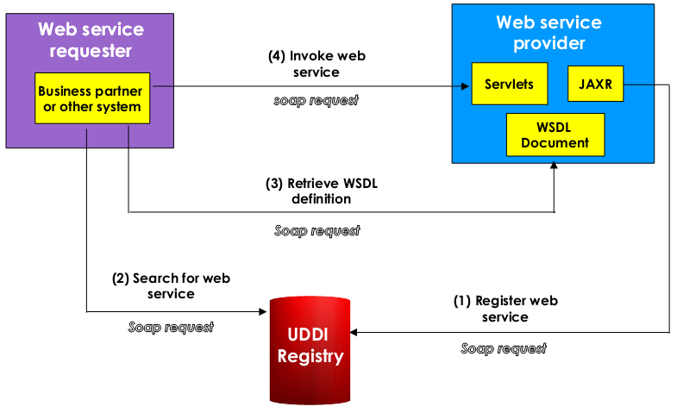
Where are SOAP annd WSDL Used?
124

Slide 125
Module 2 Summary
SOAP technology
WSDL technology

